Slide 1
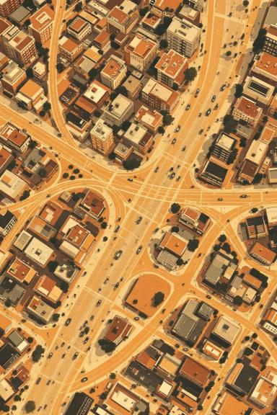
Shortest Route Using KMEANS and DBSCAN Clustering and A* Search
Marston Ward.
Nelson Arellano.

Slide 2
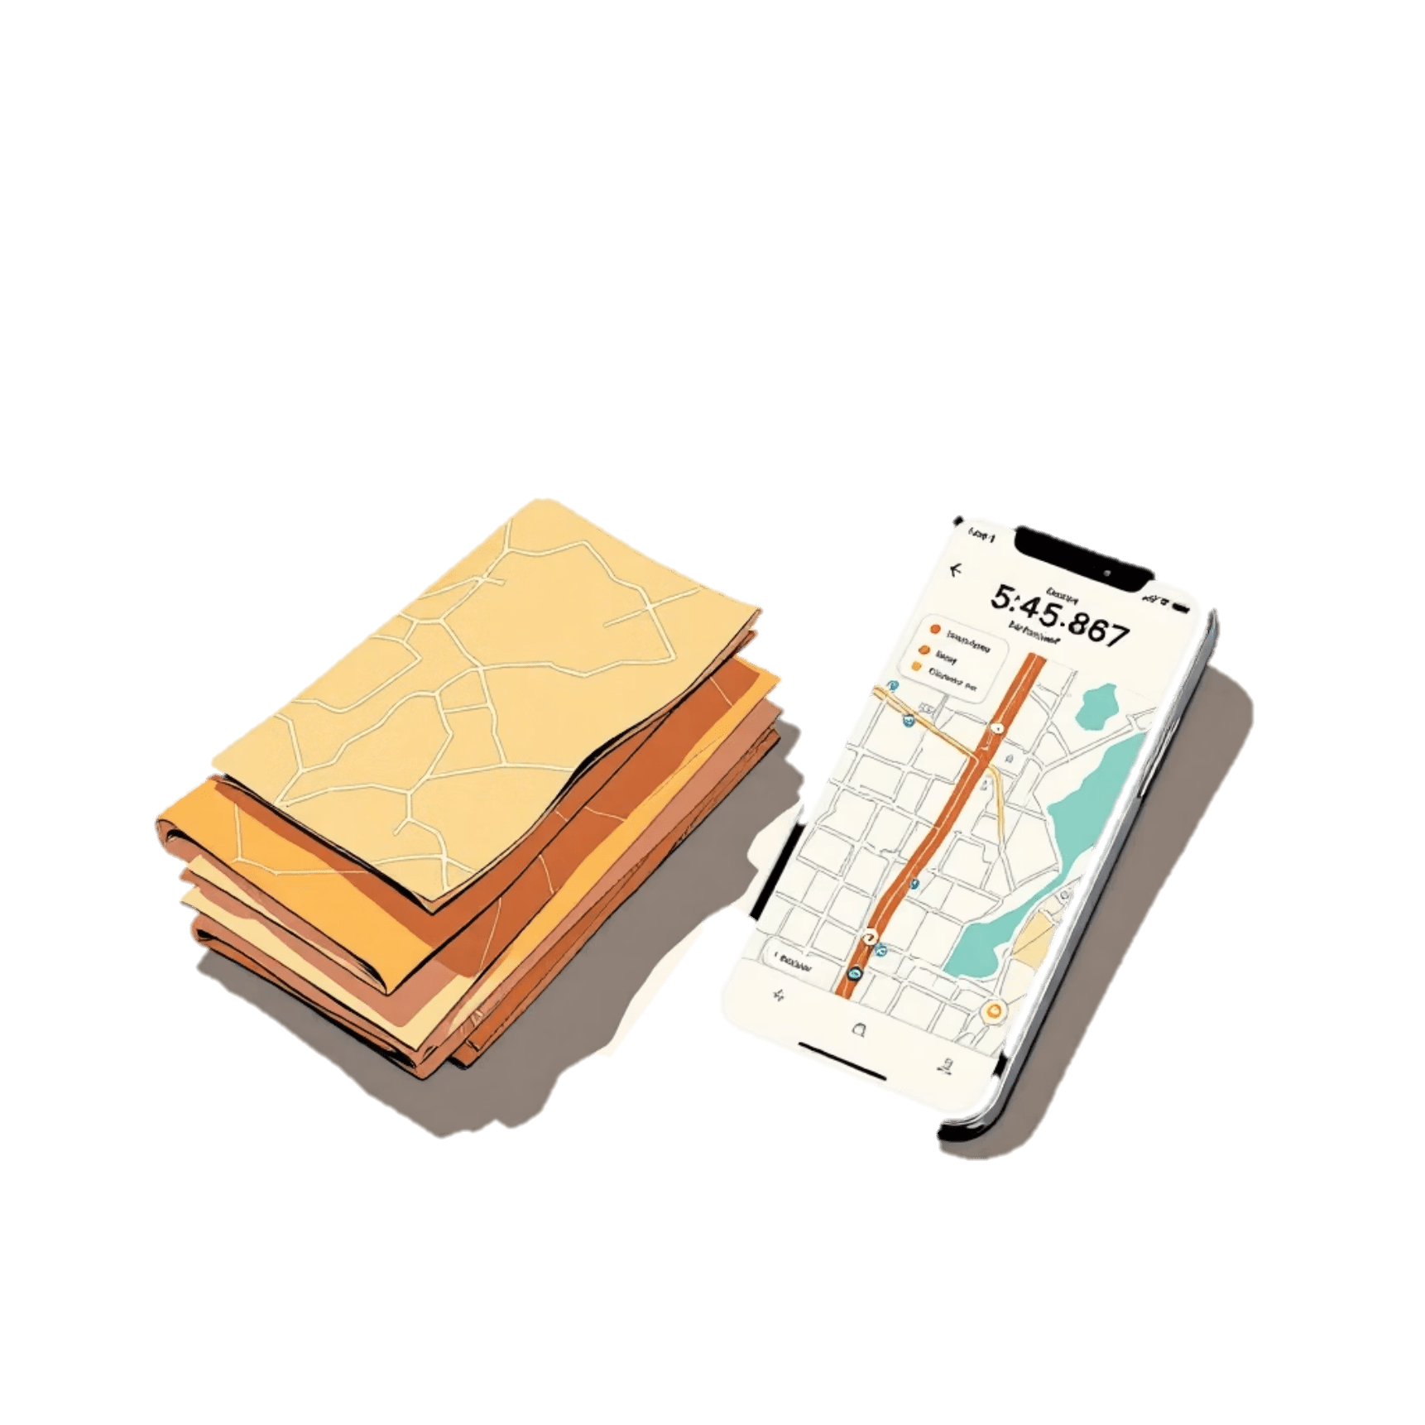
The Evolution of Navigation
Paper maps → Advance planning, limited info
Navigation apps → Real-time, route optimization
Is the shortest path always the best?
Navigation apps find the shortest route – but is that enough for on land navigation?
Notes:
A few decades ago, getting around a city required paper maps, advance planning, and a good sense of direction. Today, apps like Google Maps, Waze, and others allow us to find the fastest route in seconds, using real-time data and efficient algorithms like Dijkstra, A*, and others.
However, in urban cycling contexts, the shortest route is not always the best one. Cyclists tend to prioritize quieter, safer streets, with less traffic, or with dedicated infrastructure. This is a problem that current navigation apps still don’t fully address.
That’s why, in this project, we aimed to go beyond simple distance calculations. We wanted to explore how artificial intelligence can contribute to smarter cycling infrastructure planning, one that not only optimizes routes, but also takes into account the built environment and the user experience.
Preguntar a ChatGPT

Slide 3
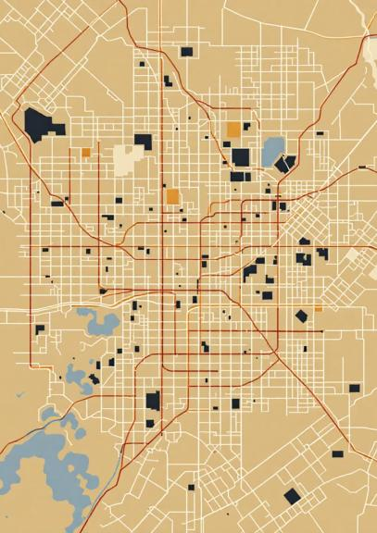



Research Methodology Overview
Data Acquisition
Source: OpenStreetMap (OSM)
Library: OSMnx
Clustering Analysis
K-Means
DBSCAN
Route Optimization
Algorithm: A* with Penalty
Notes:
This project followed a three-step methodology to build safer and more cyclist-friendly routes.
First, we acquired geospatial data from OpenStreetMap (collaborative, opensource that creates and maintain and editable world map, built by volunteers) using the OSMnx Python library, which allowed us to model the road network as a graph.
Kmeans: algorithm that groups data into a fixed number of cluster
DBSCAN: Groups closely packed points based on density.
A*

Slide 4
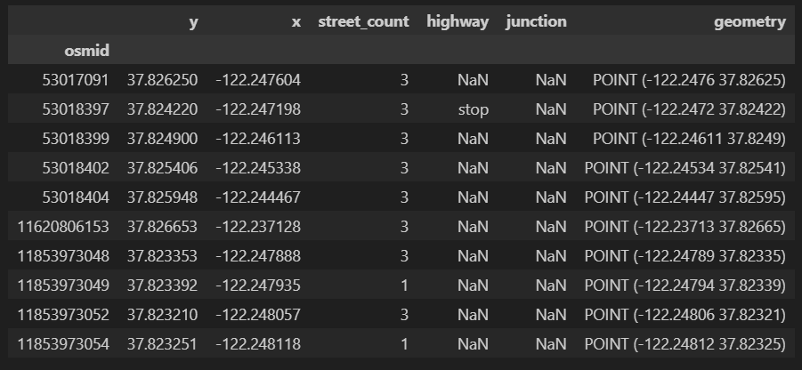
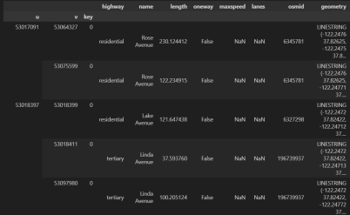
Data acquisition
Study Area Selection
Data Extraction
Piedmont, California, USA was chosen for its:
Manageable scale for analysis
Well-documented bike infrastructure
Data Source: OpenStreetMap (OSM)
World's largest collaborative geospatial database to ensure relevant information.
Key Tool: OSMnx
The library facilitates the automated retrieval and construction of geospatial network models from OpenStreetMap data
Notes:
**“For our study area, we selected Piedmont, California. We chose it because it offers a manageable scale for analysis and has well-documented bike infrastructure, making it ideal for testing our methodology.
For data extraction, we relied on OpenStreetMap, the world’s largest collaborative geospatial database, which provides detailed and up-to-date mapping information. To access and process this data, we used OSMnx, a Python library that automates the retrieval and construction of geospatial network models directly from OpenStreetMap.
On the left, you can see an example of the nodes dataset — each row represents an intersection or a point in the network with attributes such as coordinates, street count, and classification. On the right, we have the edges dataset — these are the street segments connecting the nodes, with information like road type, name, length, speed limit, and geometry. Together, these datasets form the basis of our analysis.”**

Slide 5
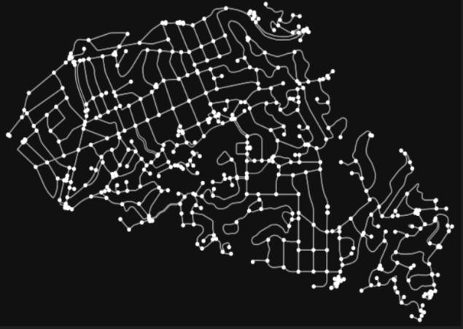
Street Network Graph of Piedmont, California
Notes:
Here we can see the graph representation of Piedmont’s bike street network. Each node represents an intersection, and the edges are street segments. This structure allows us to apply graph algorithms like clustering or shortest-path search efficiently.

Slide 6
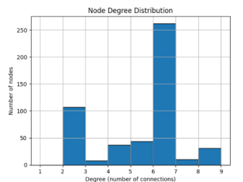
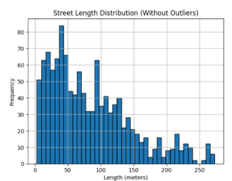
Node Degree Distribution
Street Length Distribution
Notes:
**“On the left, we have the Node Degree Distribution. Each bar shows how many intersections, or nodes, have a given number of connections. In our case, most nodes have a degree of 6 — which is expected because we modeled the network as a directed graph, so each direction of travel counts separately. This means a typical four-way intersection can appear as six connections, indicating high local connectivity.
On the right, we see the Street Length Distribution without outliers. Most street segments are short, clustered around 50 meters, which is common in dense residential areas. This has an impact on routing: shorter segments mean more decision points for the algorithm, and potentially more flexibility in adjusting routes for safety or comfort.”**

Slide 7




Feature Engineering for Road Network Analysis
Centroid Calculation
Categorical Transformation
Calculate the (x, y) coordinates of each street segment’s midpoint to represent its spatial position.
Convert road type classifications into numerical format using one-hot encoding
Feature Concatenation
Standardization
Merge spatial coordinates with the encoded road type attributes to form the full feature set
Normalize all features using StandardScaler to prevent scale bias during clustering
Notes:
In order to cluster the street segments effectively, we first needed to prepare the data by performing several feature engineering steps.
First, we calculated the centroid of each road segment to get its approximate geographic position. This gave us a pair of coordinates (x, y) that serve as a spatial proxy for each segment.
Then, we transformed the categorical road type—such as "residential", "cycleway", or "secondary"—into a numerical format using one-hot encoding. This step is crucial since machine learning algorithms like K-Means or DBSCAN require numerical input.
After that, we combined the spatial coordinates with the encoded road types to create a unified feature set that represents both location and type of infrastructure.
Finally, we applied StandardScaler to normalize all features. This step ensures that no single variable dominates the clustering due to differences in scale, especially since coordinates and encoded features may vary widely in their numerical ranges.

Slide 8
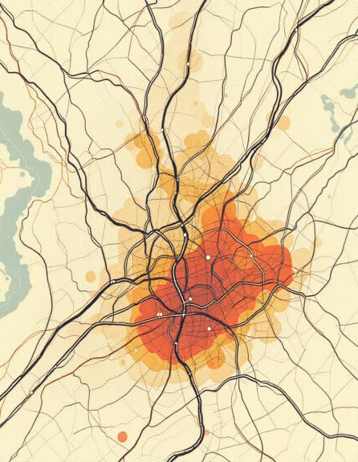
Clustering Analysis of the Road Segments
Group street segments with similar characteristics to reveal patterns in road infrastructure.
Identifies zones with similar road types
Helps prioritize safer streets for routing.
Supports intelligent infrastructure planning.
Notes:
After preparing the road network data, we applied unsupervised clustering algorithms to identify patterns and group similar street segments.
The goal of clustering here is to uncover zones with homogeneous street types, which helps us later prioritize residential areas for safer cycling routes.
We used two different algorithms: K-Means and DBSCAN, each with distinct advantages. K-Means groups data into a specified number of clusters based on similarity, while DBSCAN is density-based and can handle noise and complex cluster shapes.
These clustering results directly influence our path planning step by identifying which parts of the city are most suitable for bike-friendly routing.

Slide 9
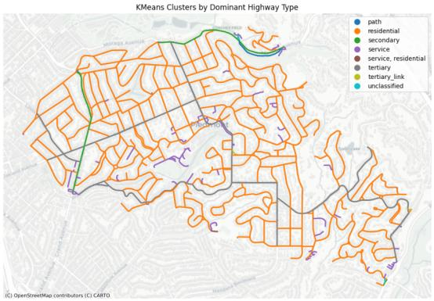
K-Means Clustering
Groups similar data points into a set number of clusters by finding patterns based on how close they are to each other.
Requires a fixed number of clusters (k = 10 in our case)
Assigns each road segment to the nearest centroid
Groups based on encoded road type and spatial coordinates
Notes:
To better understand the structure of the road network, we applied K-Means clustering to group street segments with similar features.
We specified 10 clusters, and each street segment was assigned to the nearest centroid using both spatial coordinates and encoded road type as features.
The goal was to group roads not just by location, but also by their functional role—like "residential", "cycleway", or "tertiary".
After clustering, we analyzed the dominant road type in each cluster to label them meaningfully. This information was stored in new columns that helped us later prioritize segments for route planning.
As you can see in the map, the resulting clusters show clear spatial organization, with some clusters dominated by residential streets—these became key in our safer route optimization strategy.

Slide 10
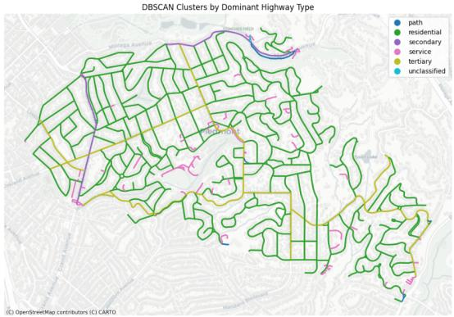
DBSCAN Clustering
Finds clusters by looking for areas where points are densely packed together, and labels points that don’t belong anywhere as noise.
Identifies core, border, and noise points
Groups points based on neighborhood density
Eps = 1.5 Max distance for neighborhood
Min_samples = 5 . Minimum neighbors to form a core point
Notes:
In contrast to K-Means, we also used DBSCAN, a clustering algorithm that groups points based on density rather than distance to a centroid.
One major advantage of DBSCAN is that it doesn’t require specifying the number of clusters. Instead, it uses two parameters: eps, which defines how close points need to be to be considered neighbors, and min_samples, which defines how many neighbors are needed to form a cluster.
This makes DBSCAN ideal for urban road networks, which often have irregularly shaped clusters and noisy data. In our case, we set eps = 1.5 and min_samples = 5, which produced well-formed clusters and filtered out segments that didn’t fit clearly into any group.
These results helped improve the quality of our routing step by focusing on dense, meaningful segments and ignoring outliers.

Slide 11

A* Algorithm
1
2
3
Standard A* Algorithm
Adaptations
Route behavior
Find the shortest path using distance and cost destination
Added penalty factor for non-residential clusters.
Modified A* prioritizes residential clusters even if the route is slightly longer.
If a road segment belongs to a cluster not dominated by "residential", the cost is multiplied by 10.
Penalized roads are avoided unless no alternative exists.
Notes:
The traditional A* algorithm finds the shortest path between two points by combining the cost traveled so far with an estimate of the remaining distance.
In our case, we wanted more than just the shortest path — we wanted safer routes. So we modified A* by adding a penalty for streets that weren’t classified as residential.
For each segment, if it belonged to a cluster dominated by non-residential roads, we multiplied its cost by 10. This encouraged the algorithm to favor calm streets, even if they were slightly longer.

Slide 12
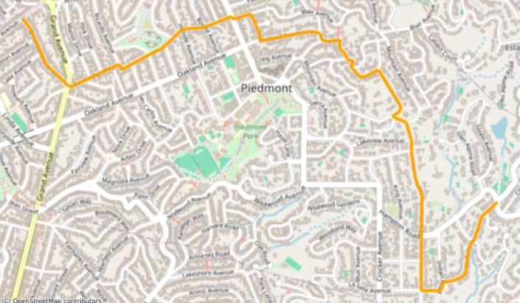
A* Algorithm (K-Means – DBSCAN)

Slide 13
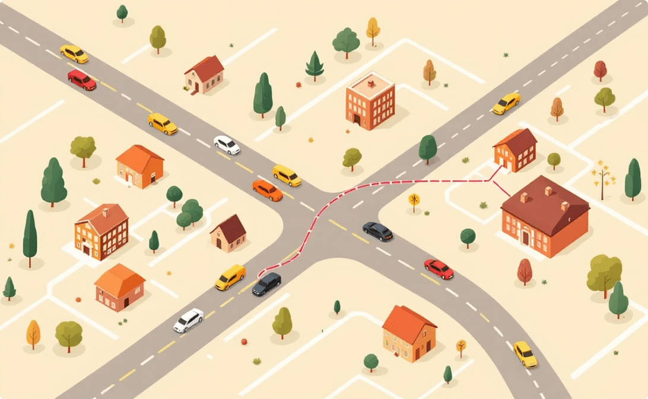


Conclusion. Future Work
Residential Preference
Clustering Consistency
Real-World Application
The algorithm successfully prioritizes traversal through clusters dominated by residential roads, even when requiring deviation from the geometrically shortest path.
Both K-Means and DBSCAN produced similar classification of residential zones, resulting in identical optimal routes despite different clustering approaches.
The resulting routes maximize safety and comfort by deliberately avoiding areas classified under other road types.

